Slide 1
PROBLEM SOLVING AND COMPUTER PROGRAMMING
Lecture 05:
Functions – Recursion

Slide 2
Recursion
  Recursion - A function calling itself with a different set of argument values.
  Every recursive function definition must contain statements to check whether to terminate the call or to call the function once again.
  Consider the factorial function:
  n! is defined as n * (n – 1)!.
  If the value of (n – 1)! is known,
  then n! can be computed as n*(n – 1)!
  So 6! = 6 * 5!, 5! = 5 * 4, 4! = 4 * 3!, 3! = 3 * 2!
  2! = 2 * 1!, 1! = 1 * 0!, 0! = 1

Slide 3
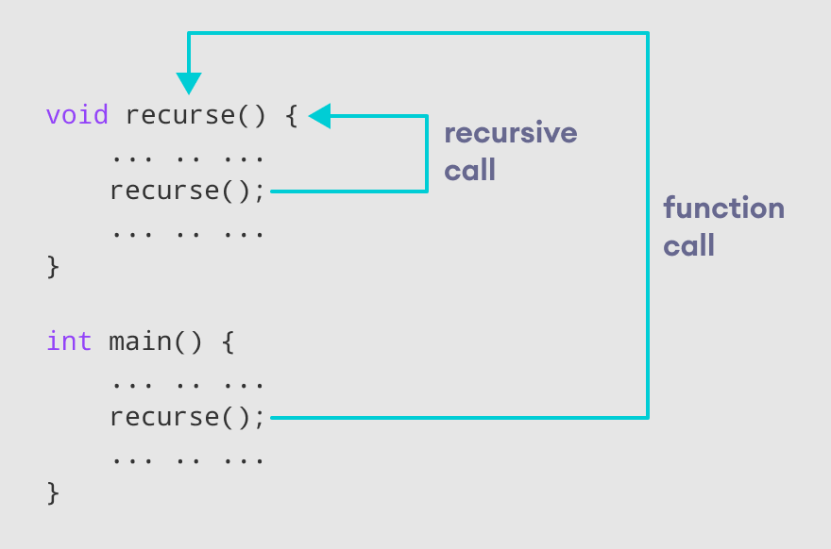

Slide 4
Recursion - Example
#include <iostream>
using namespace std;
int factorial(int n) {
if (n>1)
return n * factorial(n - 1);
else
return 1;
}
int main() {
int n, result;
cout << "Enter a non-negative number: ";
cin >> n;
result = factorial(n);
cout << "Factorial of " << n << " = " << result;
return 0;
}

Slide 5
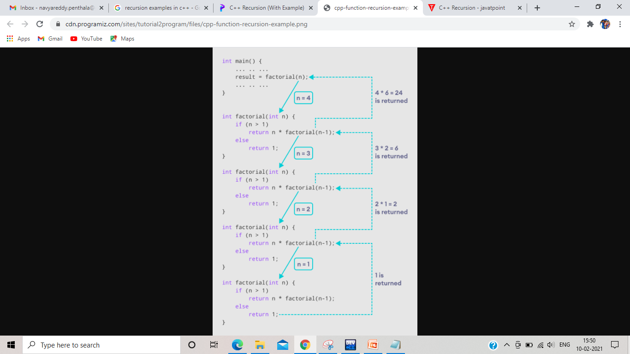

Slide 6
Recursion – nth Fibonacci Number
  Fibonacci number f_{n} = f_{n-1} + _{fn -2} for n ≥ 2.
  F₅ = f₄ + f₃, f₄ = f₃ + f₂, f₃ = f₂ + f₁, f₂ = f₁ + f₀ , f₁ = f₀ = 1

Slide 7
Recursion – nth Fibonacci Number
  Fibonacci number f_{n} = f_{n-1} + _{fn -2} for n ≥ 2.
  F₅ = f₄ + f₃, f₄ = f₃ + f₂, f₃ = f₂ + f₁, f₂ = f₁ + f₀ , f₁ = f₀ = 1
  f5
  f4 f3

Slide 8
Recursion – nth Fibonacci Number
  Fibonacci number f_{n} = f_{n-1} + _{fn -2} for n ≥ 2.
  F₅ = f₄ + f₃, f₄ = f₃ + f₂, f₃ = f₂ + f₁, f₂ = f₁ + f₀ , f₁ = f₀ = 1
  f5
  f4 f3
  f3 f2

Slide 9
Recursion – nth Fibonacci Number
  Fibonacci number f_{n} = f_{n-1} + _{fn -2} for n ≥ 2.
  F₅ = f₄ + f₃, f₄ = f₃ + f₂, f₃ = f₂ + f₁, f₂ = f₁ + f₀ , f₁ = f₀ = 1
  f5
  f4 f3
  f3 f2
  f2 f1

Slide 10
Recursion – nth Fibonacci Number
  Fibonacci number f_{n} = f_{n-1} + _{fn -2} for n ≥ 2.
  F₅ = f₄ + f₃, f₄ = f₃ + f₂, f₃ = f₂ + f₁, f₂ = f₁ + f₀ , f₁ = f₀ = 1
  f5
  f4 f3
  f3 f2
  f2 f1
  f1 f0

Slide 11
Recursion – nth Fibonacci Number
  Fibonacci number f_{n} = f_{n-1} + _{fn -2} for n ≥ 2.
  F₅ = f₄ + f₃, f₄ = f₃ + f₂, f₃ = f₂ + f₁, f₂ = f₁ + f₀ , f₁ = f₀ = 1
  f5
  f4 f3
  f3 f2
  f2 f1
  f1 f0
  1 1

Slide 12
Recursion – nth Fibonacci Number
  Fibonacci number f_{n} = f_{n-1} + _{fn -2} for n ≥ 2.
  F₅ = f₄ + f₃, f₄ = f₃ + f₂, f₃ = f₂ + f₁, f₂ = f₁ + f₀ , f₁ = f₀ = 1
  f5
  f4 f3
  f3 f2
  f2 = 2 f1
  f1 f0
  1 1

Slide 13
Recursion – nth Fibonacci Number
  Fibonacci number f_{n} = f_{n-1} + _{fn -2} for n ≥ 2.
  F₅ = f₄ + f₃, f₄ = f₃ + f₂, f₃ = f₂ + f₁, f₂ = f₁ + f₀ , f₁ = f₀ = 1
  f5
  f4 f3
  f3 f2
  f2 = 2 f1
  f1 f0
  1 1 1

Slide 14
Recursion – nth Fibonacci Number
  Fibonacci number f_{n} = f_{n-1} + _{fn -2} for n ≥ 2.
  F₅ = f₄ + f₃, f₄ = f₃ + f₂, f₃ = f₂ + f₁, f₂ = f₁ + f₀ , f₁ = f₀ = 1
  f5
  f4 f3
  f3 = 3 f2
  f2 = 2 f1
  f1 f0
  1 1 1

Slide 15
Recursion – nth Fibonacci Number
  Fibonacci number f_{n} = f_{n-1} + _{fn -2} for n ≥ 2.
  F₅ = f₄ + f₃, f₄ = f₃ + f₂, f₃ = f₂ + f₁, f₂ = f₁ + f₀ , f₁ = f₀ = 1
  f5
  f4 f3
  f3 = 3 f2
  f2 = 2 f1 f1 f0
  f1 f0
  1 1 1

Slide 16
Recursion – nth Fibonacci Number
  Fibonacci number f_{n} = f_{n-1} + _{fn -2} for n ≥ 2.
  F₅ = f₄ + f₃, f₄ = f₃ + f₂, f₃ = f₂ + f₁, f₂ = f₁ + f₀ , f₁ = f₀ = 1
  f5
  f4 f3
  f3 = 3 f2 = 2
  f2 = 2 f1 f1 f0
  f1 f0
  1 1 1 1 1

Slide 17
Recursion – nth Fibonacci Number
  Fibonacci number f_{n} = f_{n-1} + _{fn -2} for n ≥ 2.
  F₅ = f₄ + f₃, f₄ = f₃ + f₂, f₃ = f₂ + f₁, f₂ = f₁ + f₀ , f₁ = f₀ = 1
  f5
  f4 = 5 f3
  f3 = 3 f2 = 2
  f2 = 2 f1 f1 f0
  f1 f0
  1 1 1 1 1

Slide 18
Recursion – nth Fibonacci Number
  Fibonacci number f_{n} = f_{n-1} + _{fn -2} for n ≥ 2.
  F₅ = f₄ + f₃, f₄ = f₃ + f₂, f₃ = f₂ + f₁, f₂ = f₁ + f₀ , f₁ = f₀ = 1
  f5
  f4 = 5 f3
  f3 = 3 f2 = 2 f2 f1
  f2 = 2 f1 f1 f0
  f1 f0
  1 1 1 1 1

Slide 19
Recursion – nth Fibonacci Number
  Fibonacci number f_{n} = f_{n-1} + _{fn -2} for n ≥ 2.
  F₅ = f₄ + f₃, f₄ = f₃ + f₂, f₃ = f₂ + f₁, f₂ = f₁ + f₀ , f₁ = f₀ = 1
  f5
  f4 = 5 f3
  f3 = 3 f2 = 2 f2 f1
  f2 = 2 f1 f1 f0 f1 f0
  f1 f0
  1 1 1 1 1

Slide 20
Recursion – nth Fibonacci Number
  Fibonacci number f_{n} = f_{n-1} + _{fn -2} for n ≥ 2.
  F₅ = f₄ + f₃, f₄ = f₃ + f₂, f₃ = f₂ + f₁, f₂ = f₁ + f₀ , f₁ = f₀ = 1
  f5
  f4 = 5 f3
  f3 = 3 f2 = 2 f2=2 f1
  f2 = 2 f1 f1 f0 f1 f0
  f1 f0
  1 1 1 1 1 1 1

Slide 21
Recursion – nth Fibonacci Number
  Fibonacci number f_{n} = f_{n-1} + _{fn -2} for n ≥ 2.
  F₅ = f₄ + f₃, f₄ = f₃ + f₂, f₃ = f₂ + f₁, f₂ = f₁ + f₀ , f₁ = f₀ = 1
  f5
  f4 = 5 f3
  f3 = 3 f2 = 2 f2=2 f1
  f2 = 2 f1 f1 f0 f1 f0
  f1 f0
  1 1 1 1 1 1 1 1

Slide 22
Recursion – nth Fibonacci Number
  Fibonacci number f_{n} = f_{n-1} + _{fn -2} for n ≥ 2.
  F₅ = f₄ + f₃, f₄ = f₃ + f₂, f₃ = f₂ + f₁, f₂ = f₁ + f₀ , f₁ = f₀ = 1
  f5
  f4 = 5 f3 = 3
  f3 = 3 f2 = 2 f2=2 f1
  f2 = 2 f1 f1 f0 f1 f0
  f1 f0
  1 1 1 1 1 1 1 1

Slide 23
Recursion – nth Fibonacci Number
  Fibonacci number f_{n} = f_{n-1} + _{fn -2} for n ≥ 2.
  F₅ = f₄ + f₃, f₄ = f₃ + f₂, f₃ = f₂ + f₁, f₂ = f₁ + f₀ , f₁ = f₀ = 1
  f5 = 8
  f4 = 5 f3 = 3
  f3 = 3 f2 = 2 f2=2 f1
  f2 = 2 f1 f1 f0 f1 f0
  f1 f0
  1 1 1 1 1 1 1 1

Slide 24
Recursion – n^{th} Fibonacci Number
  In order to compute n^{th} Fibonacci number, need to find f_{n-1} and f_{n-2} and the result is sum of these two.
  f5 = f4 + f3
  = (f3 + f2) + (f2 + f1)
  = ((f2 + f1)) + (f1 + f0)) + ((f1 + f0) + f1)
  = (((f1 + f0) + f1 )) + (f1 + f0)) + (( f1 + f0) + f1)
  = 8
  Number of times the function f is to be called is ??

Slide 25
Recursion – nth Fibonacci Number
  Recursive function to compute n^{th} Fibonacci number
  int f(int n)
  {
  if (n == 0 || n == 1) return 1; // termination
  else return (f( n – 1) + f(n – 2)); // Recursion
  }
  Number of times the function f is to be called is ??
  f_{n+1} + 1

Slide 26
  // Reverse of a number using recursion
  #include<iostream>
  using namespace std;
  int rev(int num)
  {
  static int sum,r;
  if(num)
  {
  r=num%10;
  sum=sum*10+r;
  rev(num/10);
  }

Slide 27
  else
  return 0;
  return sum;
  }
  int main()
  {
  int num,x;
  cout<<"Enter a number: ";
  cin>>num;
  x=rev(num);
  cout<<"Reverse of given number is:"<<x;
  return 0;
  }

Slide 28
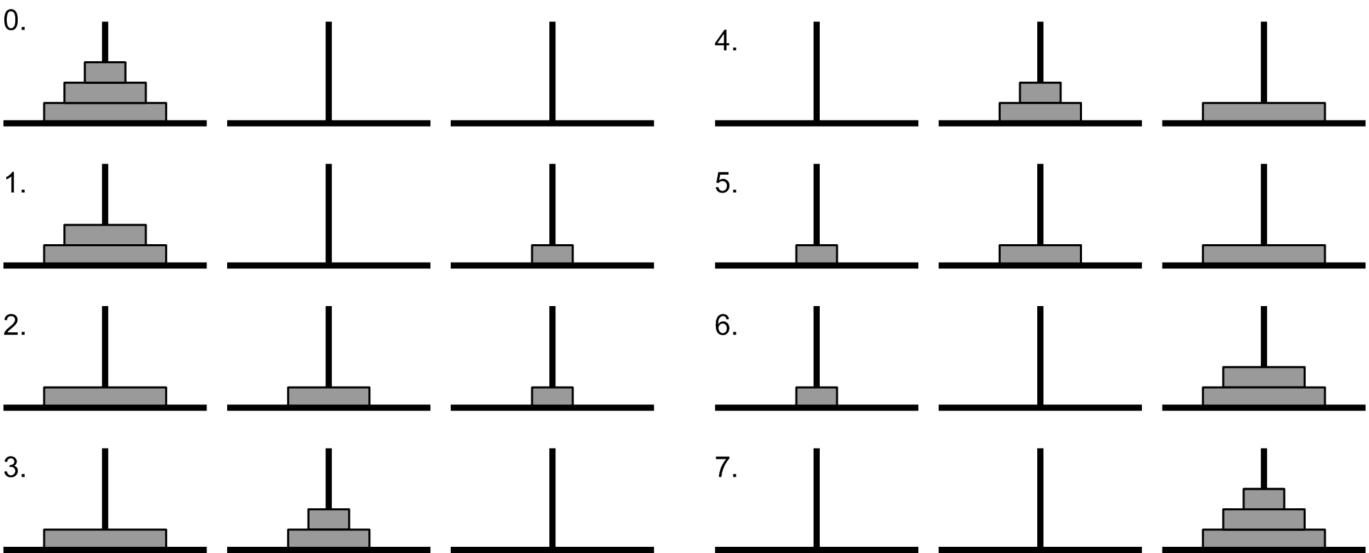
Towers of Hannoi

Slide 29
Arrays with Recursion
  // To print elements of an array
  #include <iostream>
  using namespace std;
  void print_array(int a[], int size, int i)
  {
  if (i == size) {
  cout << endl;
  return;
  }
  cout << a[i] << " ";
  i++;
  print_array(a, size, i);
  }

Slide 30
  int main()
  {
  int arr[10],n;
  cout<<"Enter n value";
  cin>>n;
  cout<<"Enter array elements";
  for(int i=0;i<n;i++)
  cin>>arr[i];
  print_array(arr, n, 0);
  return 0;
  }

Slide 31
  // Sum of elements in an array using recursion
  #include <iostream>
  using namespace std;
  int findSum(int A[], int x)
  {
  if (x <= 0)
  return 0;
  return (findSum(A, x - 1) + A[x - 1]);
  }

Slide 32
  int main()
  {
  int arr[10],n;
  cout<<"Enter n value";
  cin>>n;
  cout<<"Enter array elements";
  for(int i=0;i<n;i++)
  cin>>arr[i];
  cout<<"sum="<<findSum(arr,n);
  return 0;
  }

